Slide 1
DISTRIBUTED DATABASE
By Jawad Ahmed
Slide
1

Slide 2
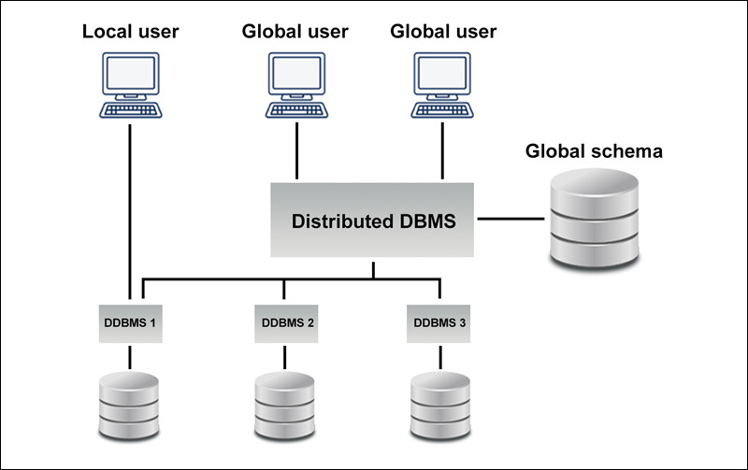
DISTRIBUTED DATABASE
Introduction
Since 2020, data creation has nearly doubled — 55.8 zettabytes in 3 years
Demand for scalable, high-performance, and secure data storage is rising
Organizations require solutions for various data types (structured & unstructured)
Distributed databases offer flexibility, scalability, and multi-user access
Data is stored across multiple servers or nodes (often geographically separate)
Slide
2
Notes:
Since 2020, we’ve seen an enormous surge in data generation — about 55.8 zettabytes more in just three years.
This explosion of data has made it essential for organizations to move toward storage solutions that are flexible, scalable, and high-performing. These systems must handle both structured and unstructured data, ensure integrity, and accommodate simultaneous access by multiple users — often from mobile devices.
Distributed databases are meeting this demand effectively. Instead of storing data in a single location, they distribute it across multiple physical or virtual machines — sometimes across regions — to boost availability, speed, and reliability.

Slide 3
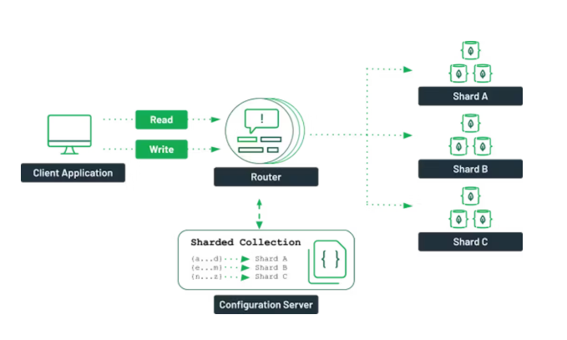

Slide 4
DISTRIBUTED DATABASE
Types of Distributed Database
Homogeneous Distributed Databases
Same data model and DBMS across all nodes
Same operating system and vendor
Consistent data schema and format
Heterogeneous Distributed Databases
Different data models, OS, and DBMS
Varying data schemas across nodes
Middleware required for communication
Nodes may be unaware of each other
Slide
4
Notes:
Distributed databases come in two main types:
homogeneous and heterogeneous.
In a homogeneous distributed database, all the systems involved use the same hardware, software, operating system, and data model. This uniformity makes it easier to manage and ensures compatibility. Often, the same vendor supplies all components, simplifying integration.
On the other hand, a heterogeneous distributed database connects different systems — these might run different operating systems, use different data models, and contain different schemas. These systems typically require middleware or translation software to allow communication. In some cases, one system might not even be aware of the others — making coordination and consistency more complex but offering greater flexibility.

Slide 5
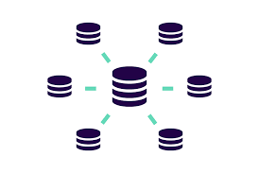
DISTRIBUTED DATABASE
How Data is Stored?
Data is stored across multiple independent nodes
Each node runs a Distributed DBMS (DDBMS)
Nodes cooperate to manage and access data efficiently
Data is divided across nodes by rows or columns
Slide
5
Notes:
Distributed databases work by storing data across multiple machines, called nodes. These nodes can be servers, computers, or virtual machines, and they don’t share any physical components.
Each node runs its own instance of distributed database management software (DDBMS), allowing it to manage and access its portion of the data.
To function efficiently, data is split and stored across these nodes. This can be done in two ways:
By rows, where different sets of records are stored on different nodes.
Or by columns, where different fields or attributes of data are separated across nodes.
This division ensures faster access, better performance, and improved reliability.

Slide 6
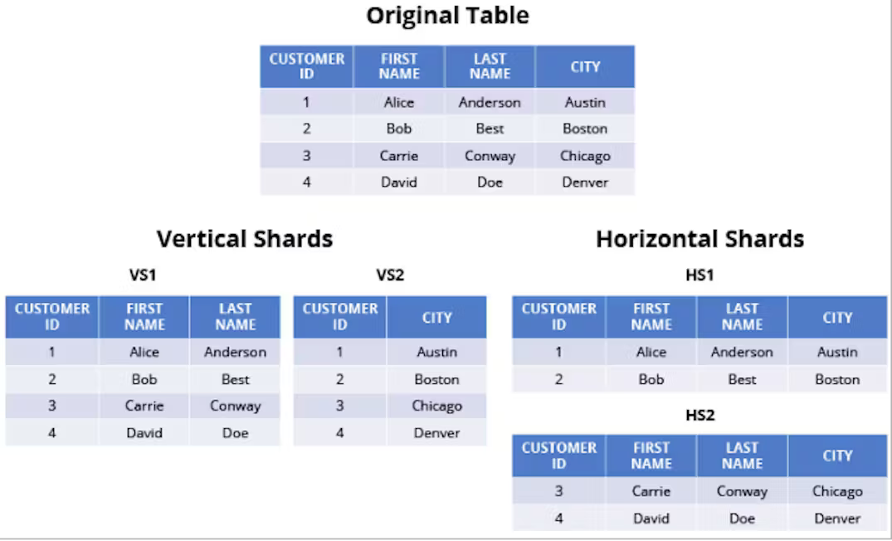
Notes:
This image shows a simple example of how a distributed database works. Imagine we have a single table called Employee, but instead of storing all its data in one place, we’ve split it across three different sites.
Site A stores the EmpID and Name columns — this could be used for general identification and HR-related queries.
Site B holds the EmpID and Phone — useful for contact or communication departments.
Site C contains the EmpID and Salary — this might be kept more secure, and only accessible by the finance team.
Even though the data is physically split, logically it still behaves like one single table. This is what makes distributed databases powerful: they provide a unified view of scattered data while optimizing performance, access, and security across locations.
Also, notice that EmpID exists in all three sites. This acts as a key to relate the data pieces back together — allowing the system to combine the data whenever needed.

Slide 7
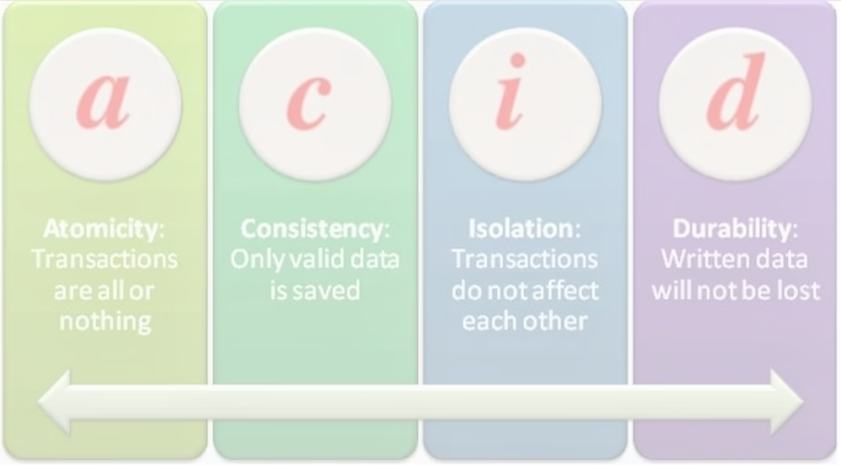
DISTRIBUTED DATABASE
Advantages
Flexibility – Supports diverse data types and schemas
Resiliency – No single point of failure
Scalability – Easy to add or remove nodes
Improved Performance – Faster response with load balancing
High Availability – Maintains access even during failures
Slide
7
Notes:
Distributed databases come with several powerful advantages:
Flexibility – They allow organizations to use different types of data structures and schemas, especially in heterogeneous systems. This is great for businesses with complex or diverse data needs.
Resiliency – Since data is stored across multiple nodes, there's no single point of failure. If one node goes down, others can still function, reducing system downtime.
Scalability – You can easily scale the system up or down by adding or removing nodes. This is perfect for organizations that are growing or changing their data needs.
Improved Performance – These systems use load balancing and query optimization to handle user requests faster, which reduces waiting time and improves user experience.
High Availability – Thanks to features like data replication and continuous monitoring, distributed databases are built for fault tolerance, ensuring users have access even if part of the system fails.

Slide 8
DISTRIBUTED DATABASE
Disadvantages
Complexity – More difficult to design and manage
Latency – Slower response if not optimized
Data Consistency – Harder to maintain across multiple nodes
Higher Cost – Infrastructure and network expenses can increase
Slide
8
Notes:
While distributed databases offer many benefits, they also come with some challenges:
Complexity – Designing and managing a distributed database is more complicated than a centralized one. There are more components, more connections, and more chances for things to go wrong. Some platforms, like MongoDB Atlas, help simplify this with unified tools.
Latency – If queries need to pull data from multiple, possibly distant nodes, it can slow down performance — especially if the system isn’t well-optimized.
Data Consistency – Since data can be stored in different formats or schemas across nodes, keeping everything in sync is harder. Failures in hardware or networks can also complicate the process of restoring consistent data.
Cost – Distributed systems can cost more. You need more hardware, more storage locations, more networking, and often more skilled personnel to manage it all.

Slide 9

DISTRIBUTED DATABASE
THANK YOU
FOR YOUR ATTENTION
Slide
9

